Slide 1
BOARD MEMBERS Centre for Fiscal Affairs
January 2024

Slide 2

Board Members intro
CFA has a fully constituted Board of Directors in compliance with the Companies Act 17 of 2015.
Duties
The duty to act within powers(Section 142)
Duty to promote the success of the company (Sec.143)
Duty to exercise independent judgment (Sec. 144)
Duty to exercise reasonable care, skill and diligence (Sec. 145)
Duty to avoid conflict of interest (Sec. 146)

Slide 3
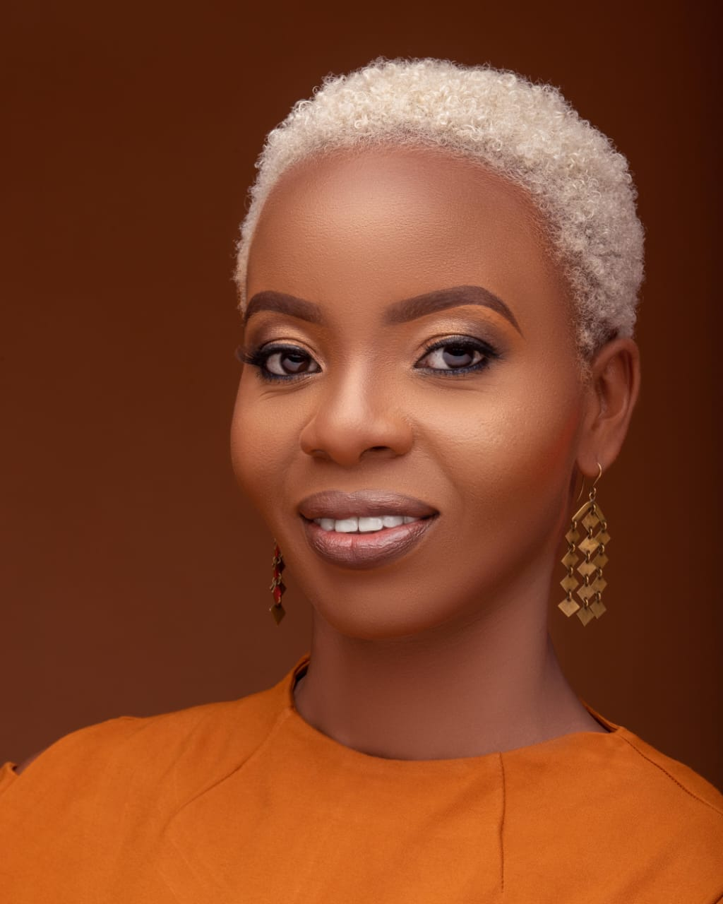
Blandina Bobson-Board Chairperson
Blandina Bobson is the Director of Programmes for Oxfam in Kenya heading the Women’s Rights and Gender Justice, Governance and Accountability and Natural Resources Programmes. She has over 15 years’ experience leading the conceptualization, design, resource mobilization, implementation, Monitoring and Evaluation of both development and humanitarian programmes within the Africa region. She is a trained Safeguarding Focal Person and Safeguarding Investigator Blandina is a champion for women rights and is passionate about Women and Girls Empowerment. Her passion for championing women’s rights is driven by her own lived experiences as a girl and a woman from a marginalized and minority community in Kenya. She works towards amplifying the voices of women and marginalized groups through research, thought pieces, strengthening Women’s Rights Organisations and challenging both formal and informal patriarchal systems that propagate gender inequalities and prevent women and girls from enjoying their rights and achieving their full potential in life. Blandina holds a Bachelor of Arts Degree in Sociology, Bachelor of Arts Degree in Sustainable Human Development; and currently pursuing a Master’s in Humanitarian Aid and International Relations. She is a certified Monitoring and Evaluation practitioner and a Global Public Voices Fellow at Cornell University where she focused on advocacy on inequalities and social injustices.

Slide 4
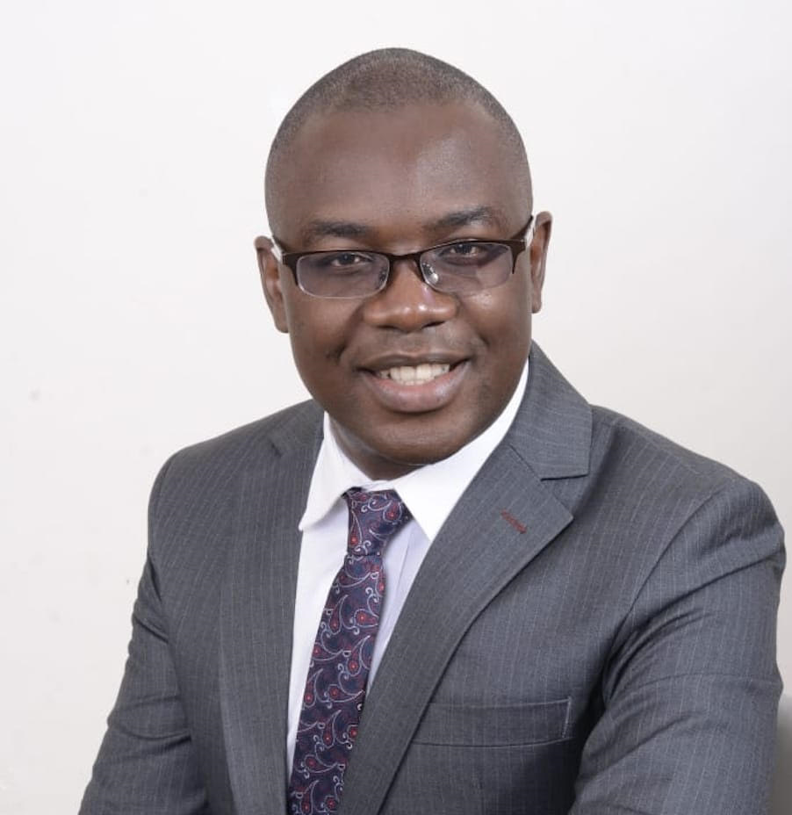
Javas Bigambo-Board Vice Chair
Javas Bigambo is a multidisciplinary professional who serves as a consultant and advisor in the fields of governance & democracy, constitutional law and legal compliance, devolved governance, public policy, political strategy, and climate change governance. He is keen on issues at the intersection of law, policy, and governance. He has studied Law, Political Sociology and Development Studies. His work experience has left footprints across county governments, NGOs, INGOs, private sector, state corporations and constitutional commissions.
He holds a Bachelor’s degree in Laws (LLB Hons) from the University of Nairobi; MPhil (HRD) from Moi University; and BA (Political Science & Sociology) from Moi University.

Slide 5
Harriet Wachira-Board Treasurer
Harriet Wachira is the Program Coordinator at Transparency International Kenya. She holds a Bachelor of Education (Arts) degree from the University of Nairobi. Has over 14 years’ experience in the governance and anti-corruption sector with Kenya and the East African Region. A significant portion of her work was spent conducting research at Transparency International Kenya during which time several knowledge products (including East Africa Bribery Index, County Governance Status Report, and Business Integrity Country Agenda )were produced. She has since moved to public policy advocacy that includes analysis and implementation.
Her experience spans different thematic areas including extractives, climate change, policing, and public finance management among others. She sits on the technical committee of the OGP National Action Plan IV and is the CSO technical lead in charge of the Beneficial Ownership Transparency Commitments.

Slide 6
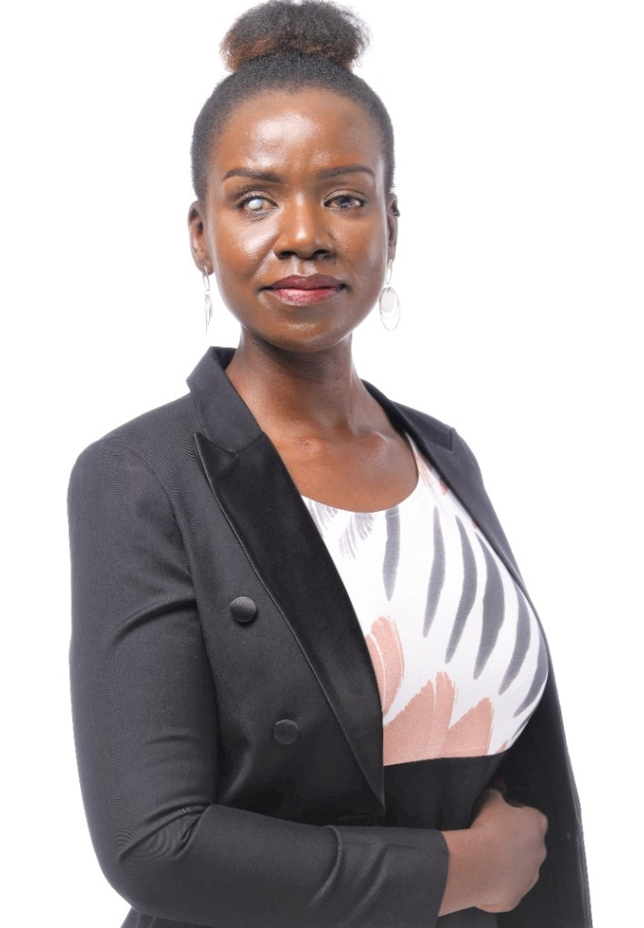
Hon. Crystal Asige, Senator
Hon. Asige is a nominated Senator in the 13th Parliament of the Republic of Kenya representing PWDs and Special Interest Groups. She is an award-winning musician, diversity equity and inclusion consultant, disability rights advocate, inclusive mobility and transport practitioner, accessibility auditor and a public speaker.
She holds a BA degree in Film Studies and Drama from the University of the West of England, Bristol, and worked at BBC Bristol, and other international media houses. She enjoys a good professional background in communication and advocacy and is passionate about promoting the rights and fundamental freedoms of all. Sen. Asige leads and consults, both locally and internationally, on projects surrounding universal design and accessibility best practices to achieve Inclusive Mobility and Development in Africa. She cross-cuts three special interest groups (PWDs, women and youth) and will push for awareness around the intersectionality of being a young, Black-African woman and a professional with an invisible disability living in the global South and challenge the unconscious and entrenched prejudices of people with disabilities.
The models she sets up to disrupt negative perceptions using what she calls ‘art-ivism’ and ‘edu-tainment’ will have exponential impacts on policies, equitable allocation of budget resources, as well as the inclusion and treatment of persons with disabilities women, youth and creatives.

Slide 7
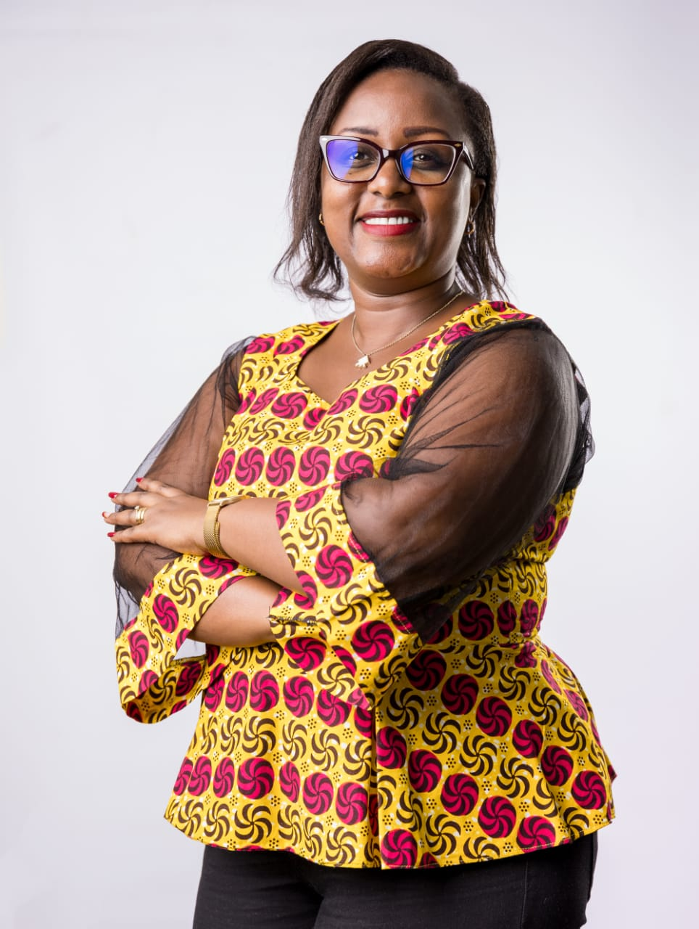
Barbra Kawira Japan
Ms. Barbara Kawira Japan is an advocate of the High Court of Kenya and a Master of Science degree holder in Governance, Peace and Security. She also holds a certificate in public leadership from the Nelson Mandela School of Governance, at the University of Cape Town. She is also a certified mediator. Her experience spans over 13 years as a governance expert at the national, regional and global level through the development of strategic plans, advocacy strategies, leadership and management manuals, among others. She has a particular interest and has worked extensively on matters human rights, gender and the law, social justice, sexual harassment advocacy, women and children rights advocacy, ethics and anti-corruption. She holds strengths in collaboration, network and partnership building, resource mobilization, ADR and Mediation, legal research, administration and management

Slide 8
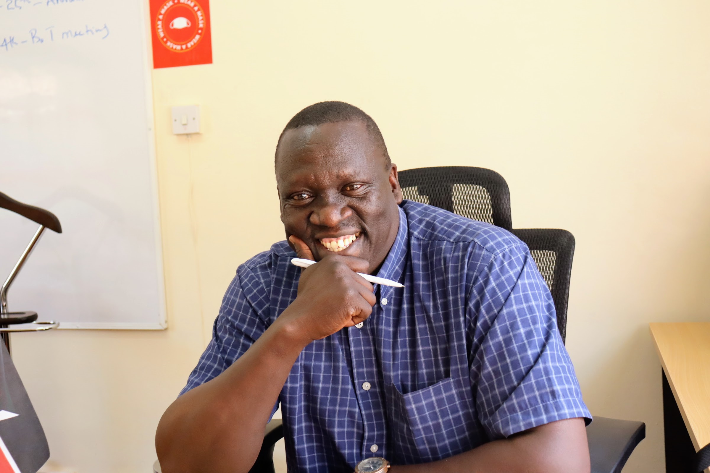
Oliver Waindi-Chair Resource and Partnership Committee
Oliver is an accomplished results-oriented executive leader with business and organizational acumen who offers extensive experience with vision and success in strategic planning, change management and pursuing a senior management role with the impetus to drive growth and impact.
His professional career includes progressive leadership within varied organizations locally, regionally and internationally. Proven track record of success in; strategic planning, social marketing, franchising, project management, capacity building and motivation, all skills that can translate equally well in varied organizational growth. Poised to provide exemplary leadership and drive. Through successful leading, coaching and behaviour management training, have successfully led numerous teams to achieve top performance in many different capacities.
He is a self-motivated, creative, strategic thinker with substantive, senior-level experience working on Civic Education; education, child programs, human rights, community health, refugees and Internally Displaced People camps. I can serve as an effective advocate and activist.
He has excellent leadership, management and organizational skills, including the demonstrated ability to lead a team of talented professionals in multiple global locations. I can juggle multiple tasks and work collegially in a demanding, diverse and fast-paced environment. I have keen political judgement, proven initiative and follow-through, and the ability to work quickly and well under pressure.
He is also a sportsman of international repute having won medals for my country in boxing in numerous international tournaments like the African Championships, World Championship and Commonwealth Games

Slide 9
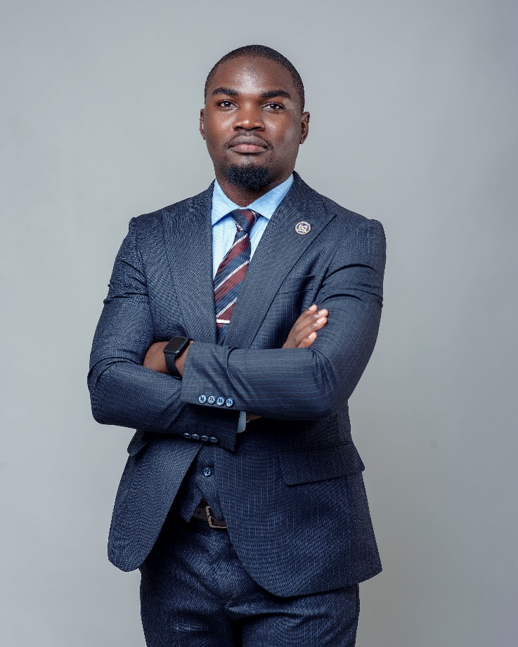
Brian George
Brian George alias Branji is a Kenyan journalist currently with Nation Media Group’s NTV. He is a Business Journalist who’s majored in Tech, Startups, Innovations and Renewable Energy.
He is a speaker, global moderator and communicator and previously a Startup judge for Techstars Startup Weekend. Prior to being at NTV he was at KTN-Standard Group where he pioneered and hosted a Startup show ‘The Innovator’ and a tech show ‘Techfile’ for 3 years.

Slide 10


